Slide 1


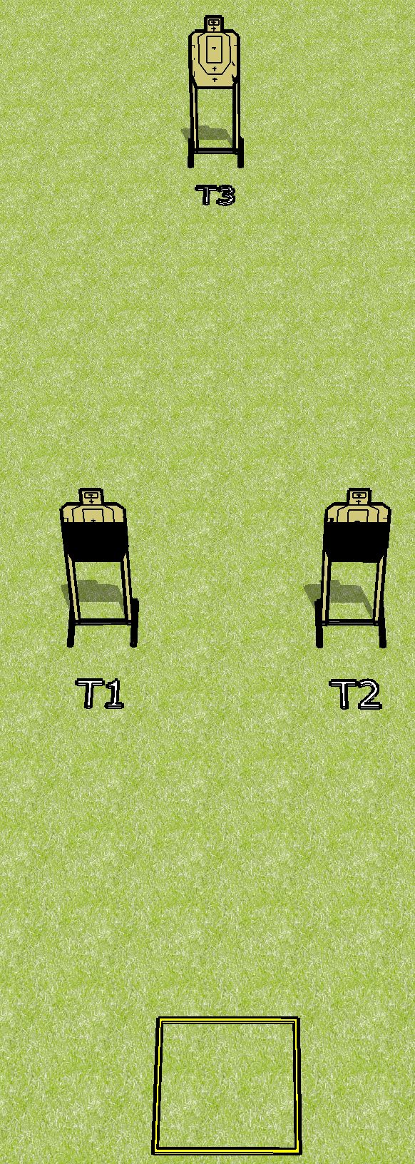
 | Dothan Gun Club – USPSA Match Thinking Man’s Game Course Designer : Drew Coleman
Round Count 18 rounds 3 USPSA
Equipment List Shooting box

Slide 2
Thinking Man’s Game
Written Stage Briefing
Thinking Man’s Game is an 18 round, 90 point, Virginia Count standard exercise. There are 3 USPSA targets. The best 6 hits on paper wills score. The start signal is audible.
Handgun start position is in shooting box, wrists below belt. Handgun is loaded and holstered.
PCC start position is in shooting box. Loaded carbine is held with both hands, stock on belt, safety on.
String 1: Engage T1 and T2 with only 3 rounds each, perform a mandatory reload and then engage T3 with only 2 rounds.
String 2: Engage T3 with only 4 rounds, perform a mandatory reload and then engage T1 and T2 with only 3 rounds each STRONG HAND ONLY.

